Slide 1


Data Analysis
For Social Buzz

Slide 2


Today's agenda
PROJECT RECAP
To give a broad understanding of the business challenge we're addressing and the specific needs, we'll present a summary of the entire project.
PROBLEM
We will delve into the specific challenge that the Data Analytics team has been focusing on and offer some background on why this issue is so important.
THE ANALYTICS TEAM
I'll begin by describing the issue and then introduce the team responsible for managing this task on our side.
PROCESS
Next, I'll walk through the general steps we took to complete this task, allowing you to fully grasp how we handle assignments of this kind.
INSIGHTS AND SUMMARY
Lastly, I will review all significant findings and offer them as a collection of understandings and illustrations from our

Slide 3

"Social Buzz" is a rapidly growing unicorn in the tech industry that must swiftly adapt to its global expansion.
Accenture has initiated the following activities during a three-month proof of concept (POC):
• An analysis of Social Buzz's utilization of big data
• Strategies for a successful initial public offering (IPO)
• An assessment to identify the top 5 content categories on Social Buzz
Project Recap

Slide 4

Problem
• In recent years, the customer has experienced significant growth and now lacks the internal resources to manage it effectively.
• Social Buzz receives over 100,000 posts daily, amounting to 36.5 million posts annually. Given that all the content is unstructured, making sense of it can be quite challenging.
• Identify the requirements that need to be met for this project.
• Merging tables from the sample data set
• Analyzing their content categories to identify the top five with the highest overall popularity.

Slide 5



Andrew Fleming
(Chief Technical Architect)
The Analytics team
Marcus Rompton
(Senior Principle)
SHIJU B
(Data Analyst)

Slide 6
Process
1
UNDERSTANDING DATA
2
DATA CLEANING
3
DATA MODELING
4
DATA ANAYSIS
5
UNCOVERING INSIGHTS

Slide 7


Insights

Slide 8
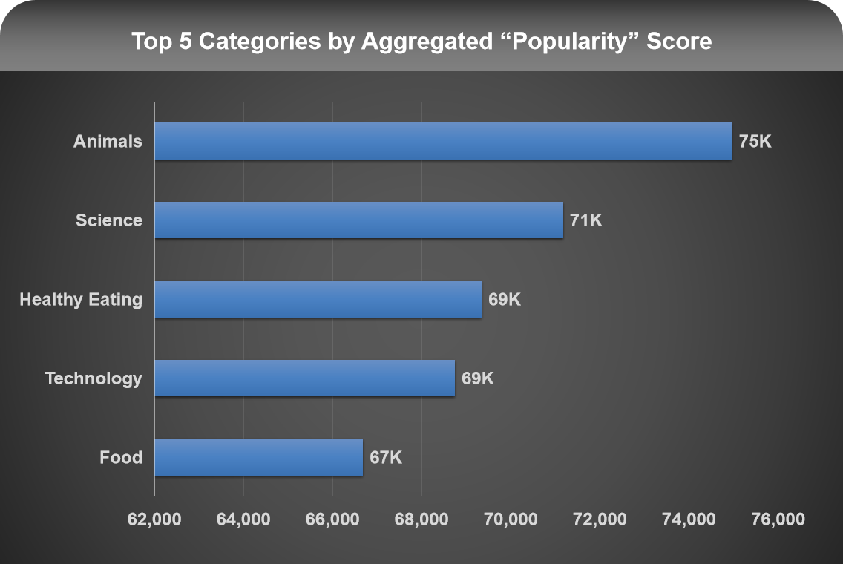

Slide 9
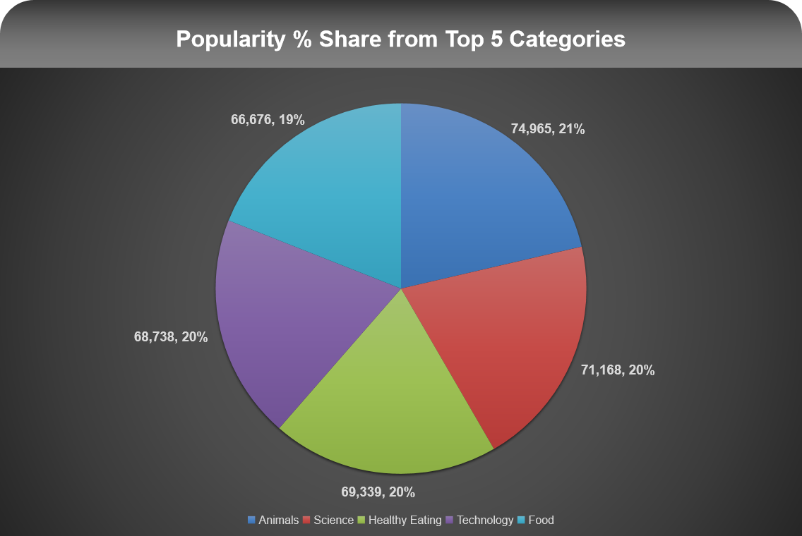

Slide 10

ANALYSIS
Animals and science are among the most favored content categories, indicating a strong preference for "real-life" and "factual" material. I suggest continuing to produce content in these areas.
INSIGHTS
Summary
Food, particularly "Healthy Eating," is a recurring theme in the top 5 categories, suggesting an interest from your audience. This insight could be leveraged to develop a campaign in collaboration with healthy eating brands to enhance user engagement.
STEPS TO BE TAKEN
Given the rapid advancement of technology, it's no surprise that technological content ranks among the top categories. This suggests that users appreciate your tech-related material. I recommend partnering with some of the world's leading digital companies, as this would likely boost user engagement significantly.

Slide 11
Thank you!
ANY QUESTIONS?

